Slide 1
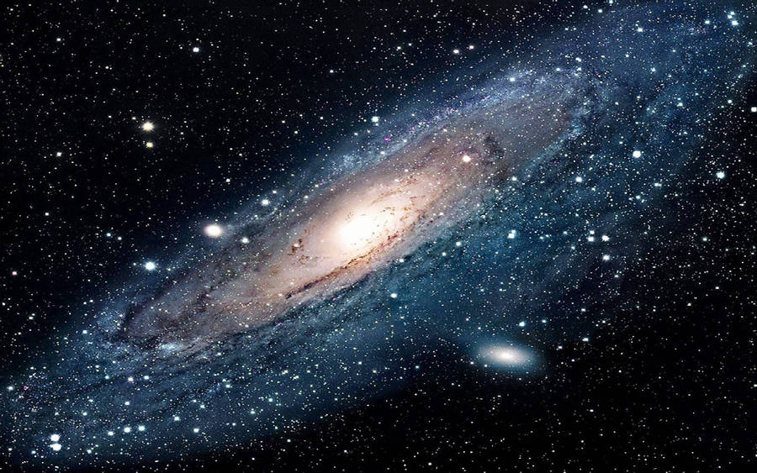
Space UP
Natacha Bartu

Slide 2
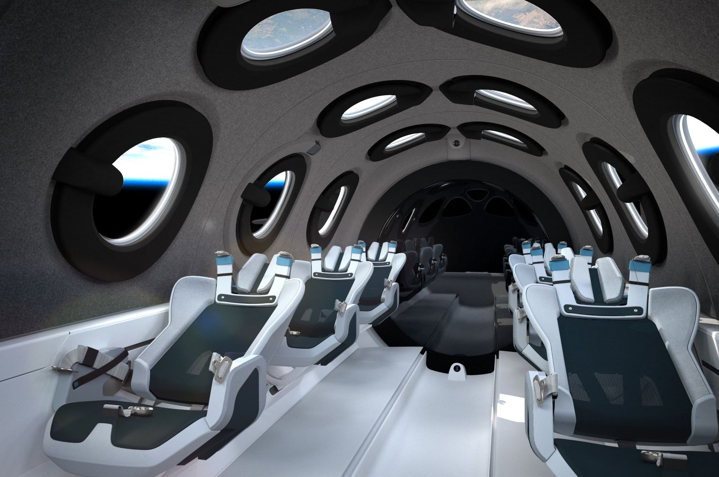
Agenda
Introduction
Functionality
Wireframes
ERD
Walkthrough to app

Slide 3
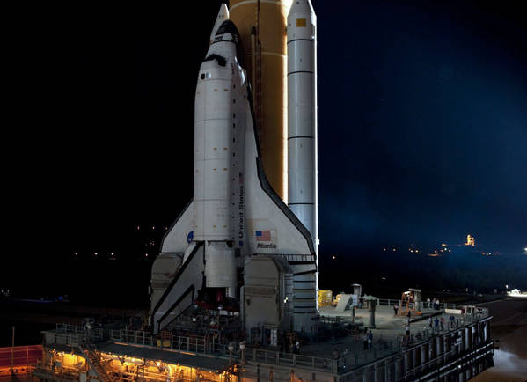
Space UP
Technology today is running as faster as usual nowadays. So why not create a trend for the future, an opportunity to travel around space. An extraordinary experience to travel around another "world." I made the app to allow the user to have a space trip, and the sellers can have the opportunity to sell packet trips to the user.

Slide 4
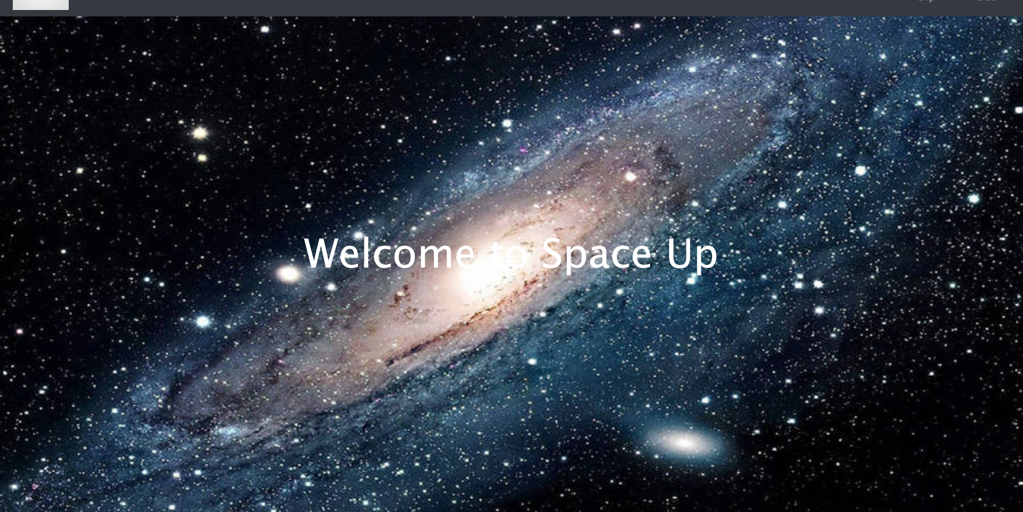
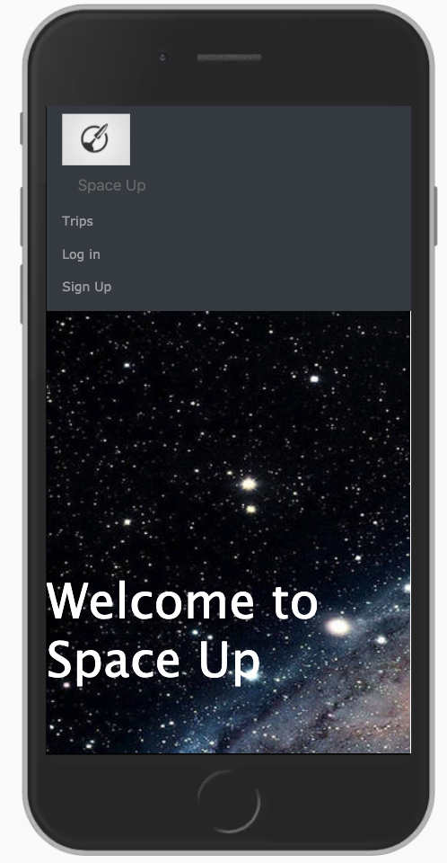
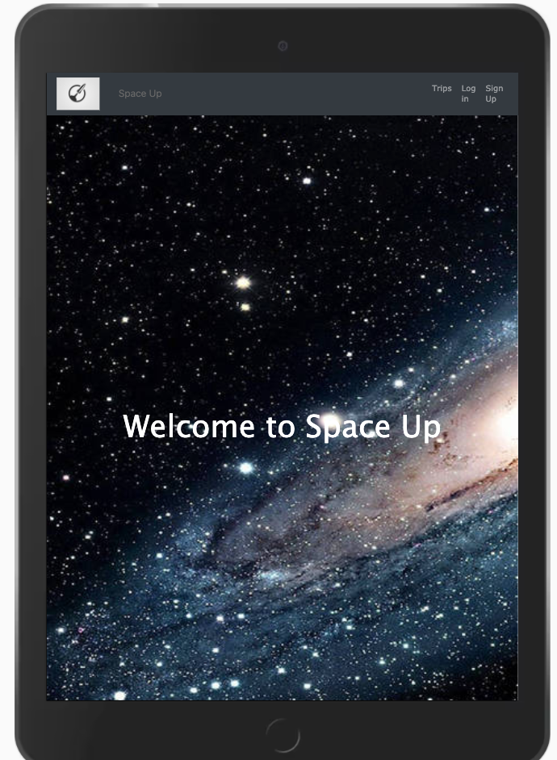
Functionality
The website will be landed on the home page. The application has Users that can be sellers or buyers. Both users, sellers and buyers, need a request to sign up. The app can have many User selling trips, and also it has been arranged by authorisation on the built application. You can update and delete the trips with the respective id user. User buyer can select the trip that would like to go, and it will also connect to the Stripe Checkout, which has been implemented on the application.

Slide 5
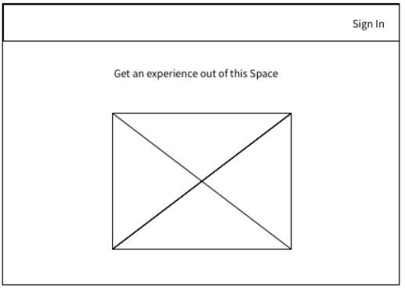
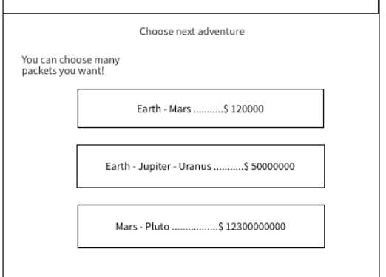
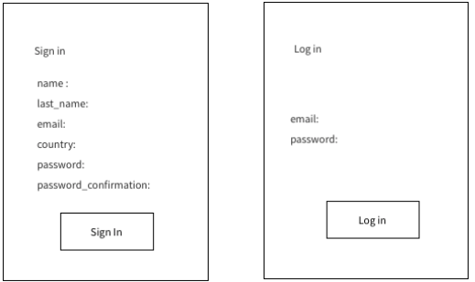
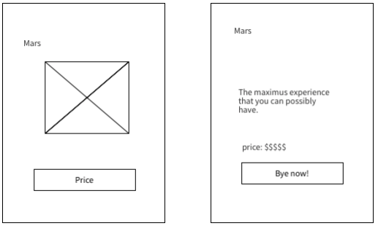
wireframe
desktop

Slide 6
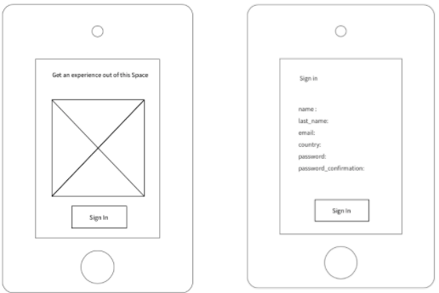
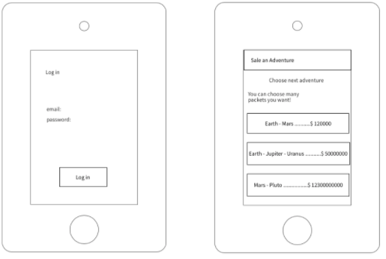
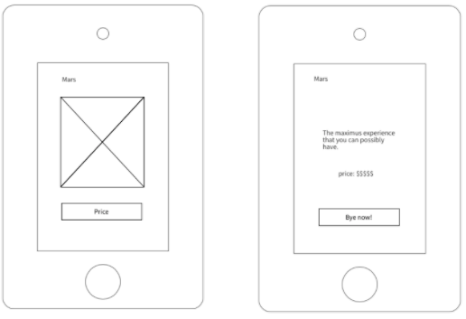
wireframe
ipad

Slide 7
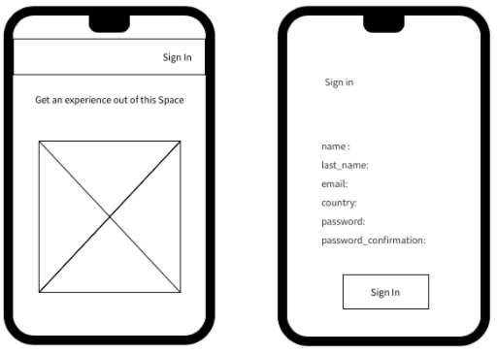
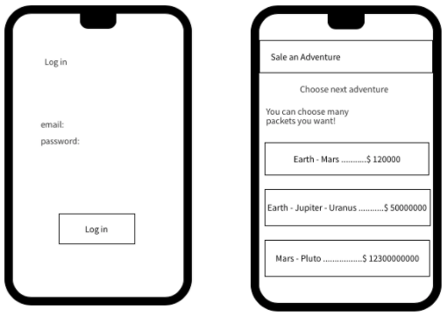
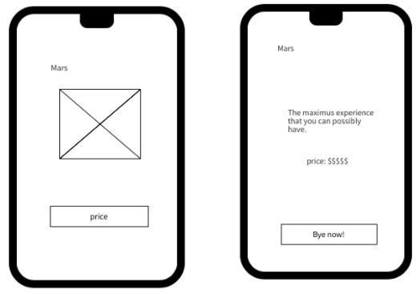
wireframe
mobile

Slide 8
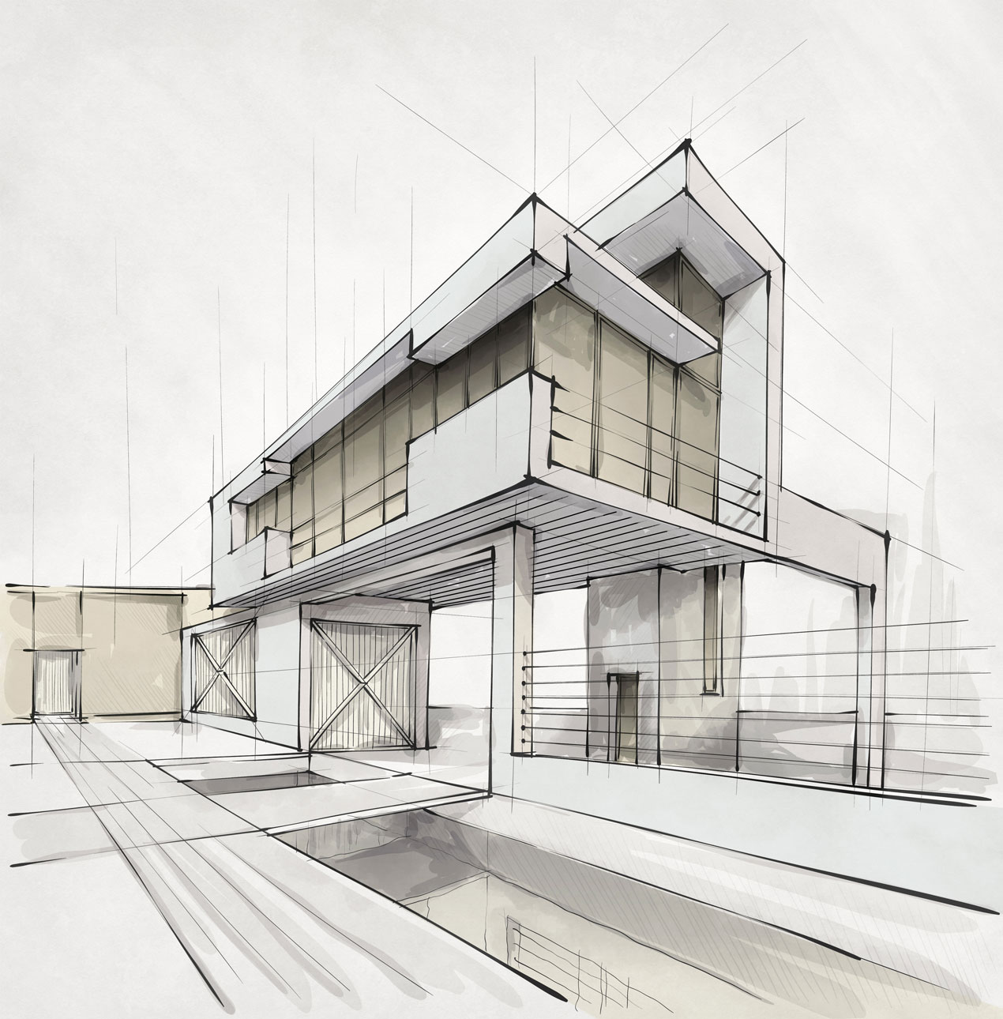
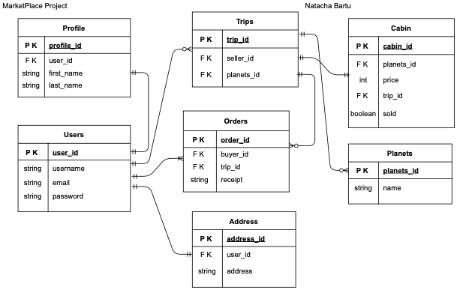
schema database design
erd
Initial Idea

Slide 9
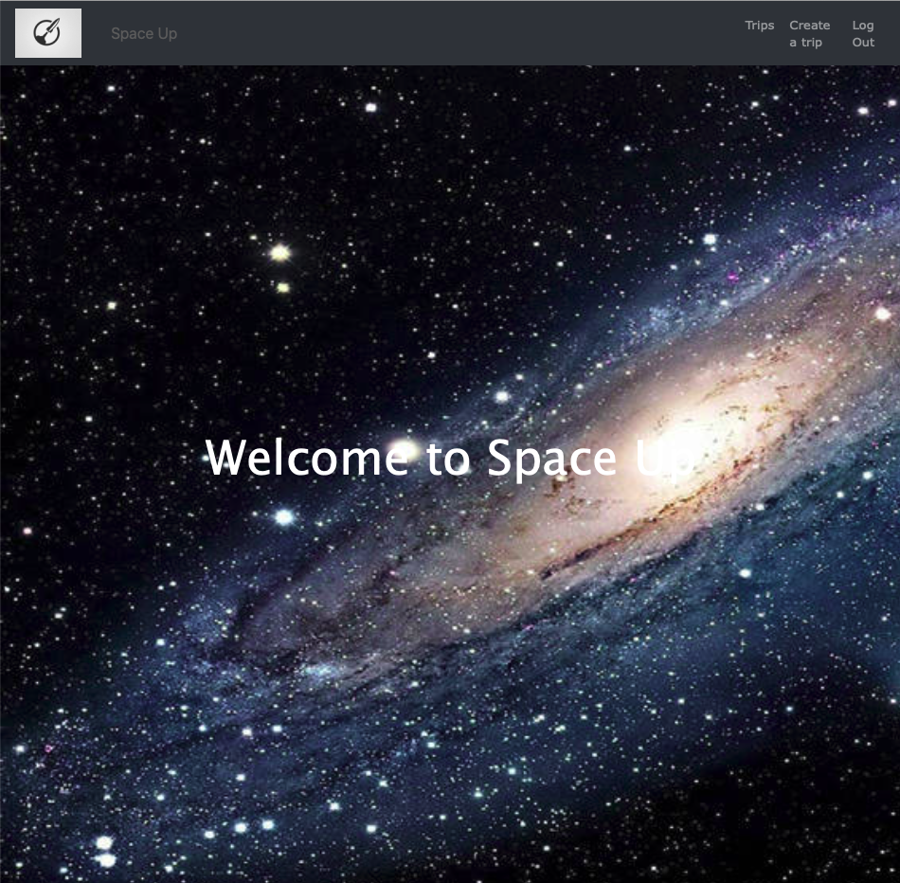
Homepage

Slide 10
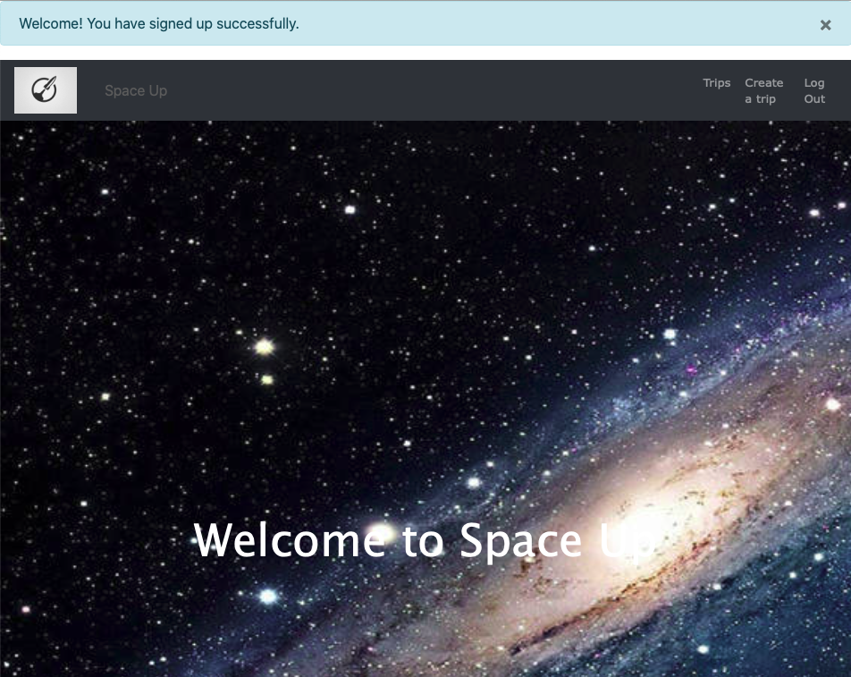
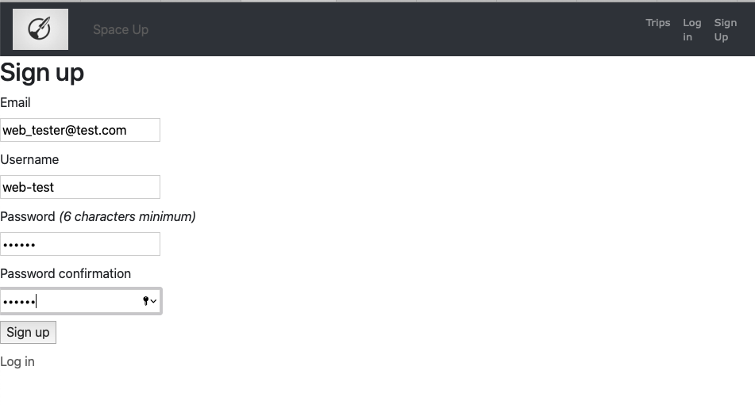
Sign Up User

Slide 11
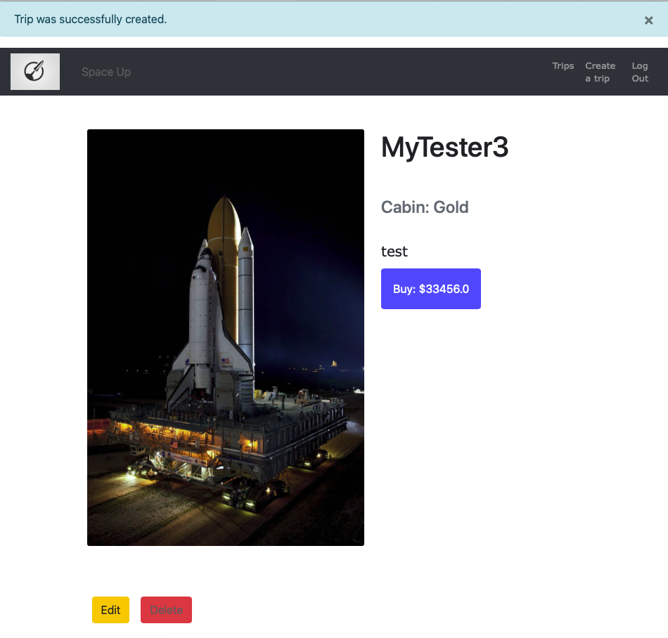
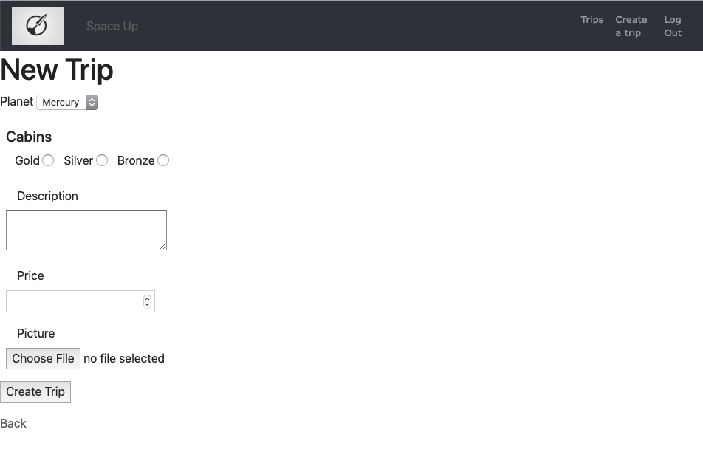
Create a Trip

Slide 12
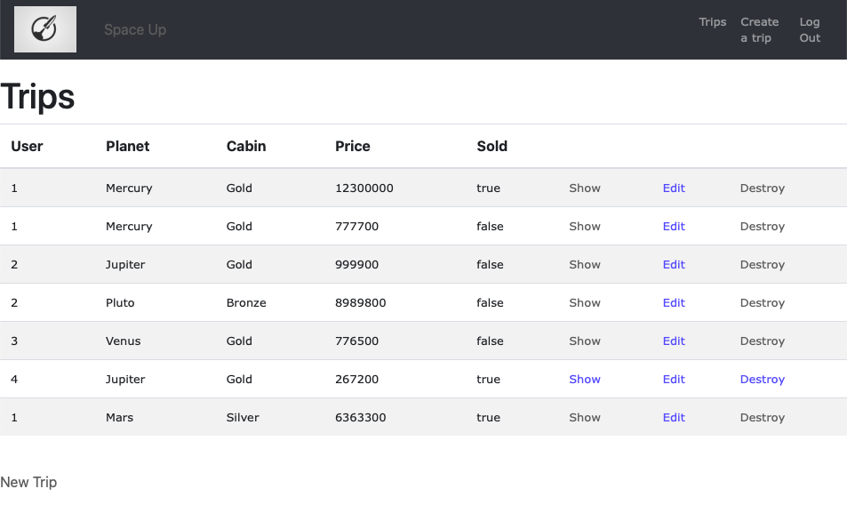
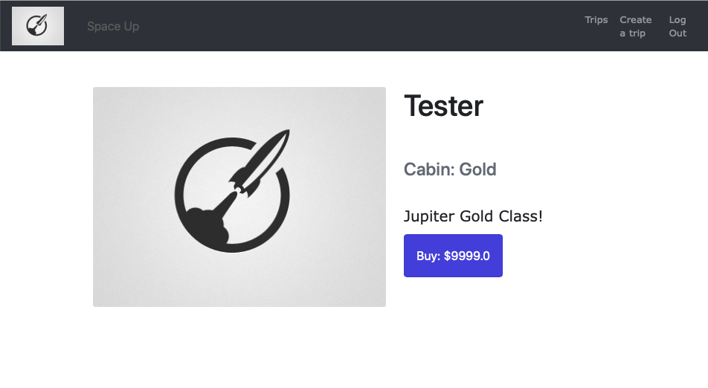
Trips
Selected Trip

Slide 13
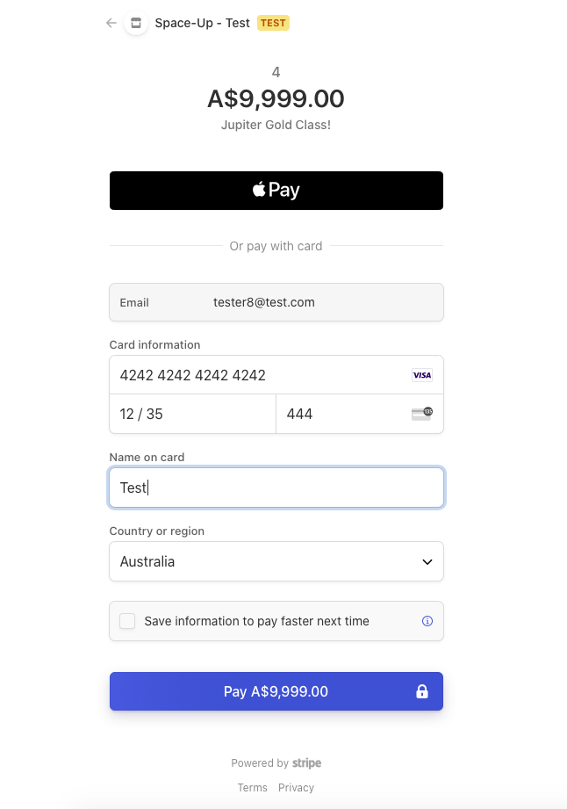
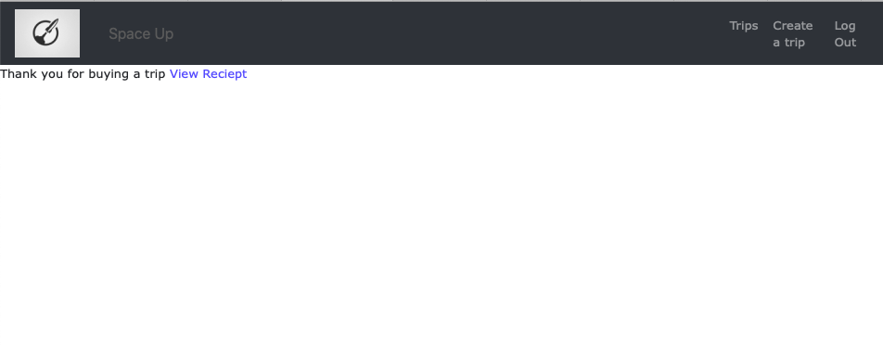
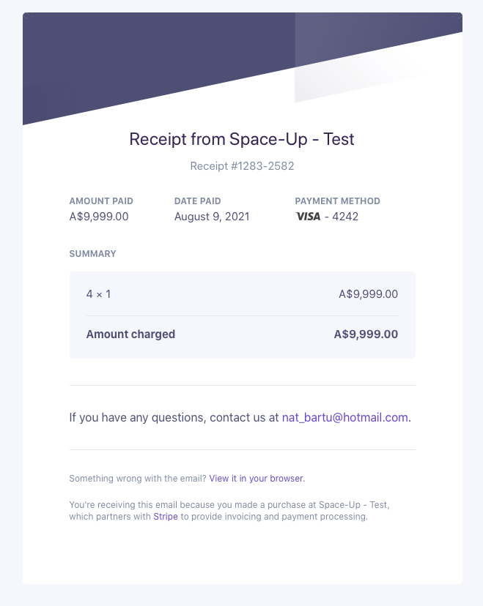
Redirect to Stripe
Redirect to receipt page
Stripe receipt

Slide 14

Thank you!

